Slide 1
COMP 2511
WEB I – CLIENT DEVELOPMENT

Slide 2

Web I: Description & Overview
This 3-credit course covers the concepts and practices necessary for client-side UI development. The course provides a technical overview of the Internet environment and the structure of the World Wide Web. The technical segment will focus on the design and implementation of a responsive and accessible Web user interface.
PREREQUISITES: A minimum grade of "C-" in all of COMP 1001 or 1501 or 1615 or 1631.

Slide 3

Course Structure
In-person, live
  3 hours lecture, 1-hour lab
    New material will be formally presented in lectures.
    The labs will be used to reinforce the concepts covered in lectures by applying them in a concrete fashion.
Attendance of all classes, including labs, is expected and is essential to success in the course
See your official MRU schedule for exact times, dates and locations.
If required to move online, lectures and labs will remain synchronously delivered – including the tests, at the same times, made available via a Google Meet.
Direct communications will be sent ONLY to your MRU Gmail account.
General information, this course outline, the topic schedule, the assessment schedule, supporting resources, readings, lecture slides, assignments etc. will be made available from the Course Resource folder.

Slide 4

Learning Objectives & Outcomes
This course will help students understand how the web works and is architected.
Students will understand the structure of the World Wide Web as interconnected hypertext documents.
Students will be able to design and implement static pages using HTML and CSS.
Students will create and validate HTML documents.
They will use CSS for advanced formatting and responsive layouts.
Students will be able to compare/contrast graphic media file format characteristics such as color depth and compression.
They will understand why accessibility issues are an important consideration in web page development and will learn techniques to design accessible Web Pages.
Students will be exposed to CSS libraries and frameworks.
Students will use version control and cloud tools to manage and deploy their websites

Slide 5

Assessments
Assignments
  2 worth 20% (10% each)
  Relatively long projects which are to be completed outside of regularly scheduled class times.
  Graded on a combination of correct and complete functionality, quality of design and readability of code. Detailed requirements, due dates, and submission instructions will be given for each assignment.
Lab Exercises
  There will be 10 lab exercises during the 12 week course
  You will submit these exercises after you have completed them. I will grade them. Your lab mark will be the best 8 out of the 10 lab exercises.
  Lab Exercises are worth 10% of the course mark.
  Lab Quiz
  There will be one lab Quiz on April 7, 2026.
  It will be worth 5% of your course mark.
  It exists to help prepare you for the ‘live’ final examination.
Engagement Exercise
Each student is required to complete the Activity ‘Succeed in University)
It will be worth 5% of your course mark.
Tests
  Midterms
    2 worth 15% each
    Written in class on the date specified on the course schedule. If any changes to these dates are necessary, students will be notified by electronic mail in advance.
    Students will not normally be permitted to write a missed test at a later date. A student seeking alternative arrangements must contact the instructor at least one week prior to the date of the test!
  Final
    30%
    Scheduled by the MRU Registrar: the exact date and time determined later in the semester. Students must remain available to write a final exam between April 9 and 23, 2025.
    Will be in two parts: on paper, and live coding on a computer. Normally 3-hours long, it will cumulatively assess all course topics.

Slide 6

Grading Notes
Assessment marks are emailed to your MRU gmail account periodically.
The final overall weighted grade is rounded to zero decimal places.
Percentages, letter grades and GPA the MRU Academic calendar policy.
Note the qualitative descriptors :
  < 50% → Fail - Does not meet academic requirement and do not withdraw.
  < 60% → Marginal performance
  < 70% → Satisfactory - Basic understanding
  < 80% → Good - Clearly above-average performance, generally complete understanding..
  >=80% → Excellent - Superior performance & comprehensive understanding

Slide 7

Resource requirements
Textbooks – None Required but…
Technologies
Fundamentals of Web Development,
  Connolly and Hoar, Pearson, 2017.
  Any addition is welcome.
  This same text (and 3rd Edition exercises) are used in Web II
Online readings may be included and will be shared in the Course Resource folder
Hardware & Internet
  A recent computer with broadband internet, over which you have administrative control.
  Phone, tablet, netbooks are NOT sufficient!
Software & Services
  Visual Studio Code
  MRU Google account
    Email, Drive

Slide 8

Third-party App Notification
Students may be asked to use third-party vendor software applications: either downloaded to a student’s computer or installed browser extensions.
  You are advised that by using them you are consenting to the potential disclosure of your personal information to external vendors which fall outside the custody and control of Mount Royal University. You should limited identifiable personal information entered into these applications to protect your personal privacy.
Students have the right to opt out of using these third-party apps and may choose another form of academic participation subject to the agreement of the instructor.
  Students must notify their instructor of their intention to opt-out before such usage is required!

Slide 9

Course policies
Attendance & Etiquette
It is expected that you will attend all lectures and all labs!
Academic accommodations
  Access and Inclusion Services office: Y201, (403) 440-6868 and accessibility@mtroyal.ca
Late submissions.
  Due dates will be included on each assignment.
  Tests and exercises are not normally accepted late.
    With advance notice, and only at the instructor’s discretion, a midterm might be accommodated but final exam deferrals must follow MRU institutional policy.
  Students are responsible for submitting working code. No mark will be given to submissions with corrupted or unopenable files.
Extensions (assignments only)
  Since the assignments will be released substantially ahead of their due date, no late submissions will be accepted.

Slide 10
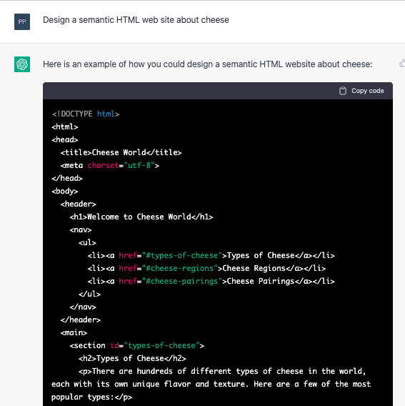
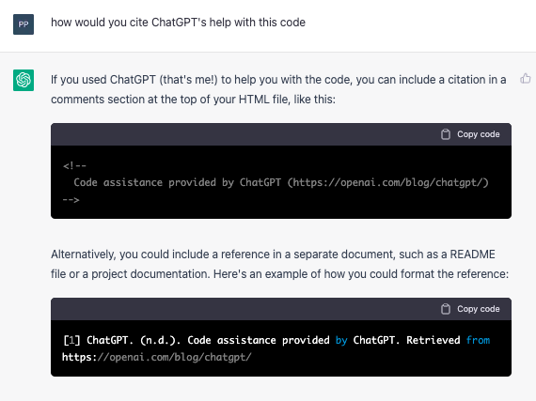
Academic Integrity
When in doubt,
drive the mouse yourself.
Office of Student Community Standards.
The use of AI is permitted but you Must recognize and cite such usage. The purpose of the class is to learn, not just do.
To use AI without citing its usage is plagiarism!
Academic dishonesty undermines
  Your education.
  Your degree’s value.
  MRU’s reputation.

Slide 11

COVID
https://thenounproject.com/icon/sick-1140486/
Stay home if ill/symptomatic.
    Mount Royal strongly recommends that University students, staff and visitors do not come to campus if they are symptomatic or ill with COVID-19 or any other communicable illness. AHS recommends you stay home and isolate for at least five days from first having symptoms of COVID-19 or had a positive test (if no symptoms present) and keep isolating until symptoms have improved and fever-free for 24 hours.
Please let your instructors know your situation. You do not need provide a doctor’s note to ‘excuse’ an absence.
    Short-term individual arrangements can be made as required.
    Long-term absences may require the involvement of MRU Access & Inclusion Services.

Slide 12

COVID
If, due to AB public health or MRU policy, we go to ‘online’ delivery:
Lectures and labs will occur at the same time but use Google Meet.
  They will be recorded, posted and available until 10 days after term ends.
Tests, exam and exercises are still ‘live’ and individual but will be reworked to be ‘open’ if necessary.
More questions? Contact Student Affairs (C201, studentaffairs@mtroyal.ca) to discuss your health and safety concerns.

Slide 13

Supports
Student Learning Services
  403.440.6452, sls@mtroyal.ca
  Early Support program
Wellness Services
  Physical & mental health
Campus Equity & Meaningful Inclusion
  For information and assistance related to human rights, equity, inclusion, discrimination, harassment, sexual violence, and related services, see
MRU IT Service desk
Department Lab Assistants
  Steve Kalmar & Jordan Pratt
  Offices behind B107 lab.
Student Association (SAMRU)
  All credit students at Mount Royal are members of the Students’ Association of Mount Royal University (SAMRU). As a member you have access to all of SAMRU’s services, the Wyckham House Student Centre, and a wide variety of student clubs where you can meet other students and build a sense of community during your time at Mount Royal.

Slide 14
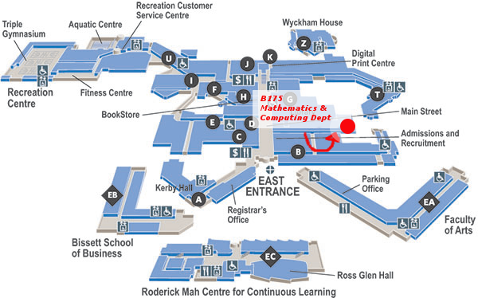
Jim Davis
Room: B102–16
jdavis@mtroyal.ca
MRU Google calendar for drop-in and bookable office hours
  It will be worth 5% of your course mark.

Slide 15
Questions?

